Slide 1
Culture: Foundation for the Learning System
Patient Safety Forum
March 30, 2017
Doug Salvador MD, MPH
Vice President, Medical Affairs
Baystate Medical Center
doug.salvadorMD@baystatehealth.org

Slide 2
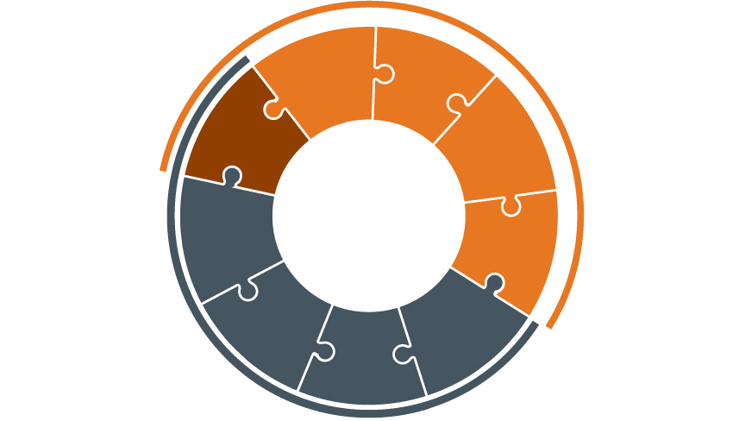
Framework for Clinical Excellence
Patient Safety
Culture
Psychological Safety
Accountability
Leadership
Teamwork &
Communication
Engagement of Patients & Family
Transparency
Negotiation
Reliability
Continuous Learning
Improvement
&
Measurement
Learning System
© IHI and Allan Frankel

Slide 3
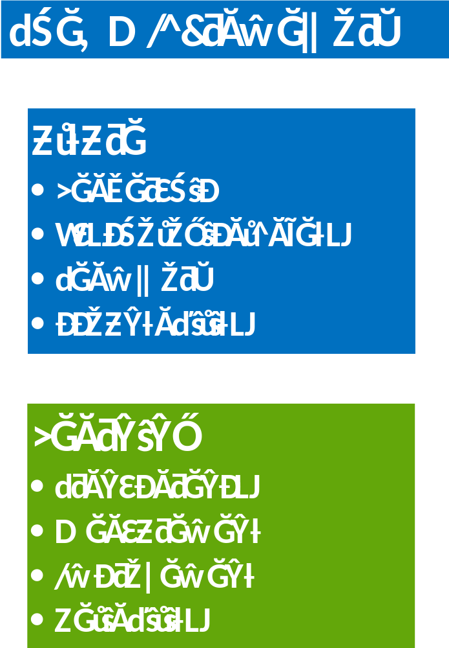
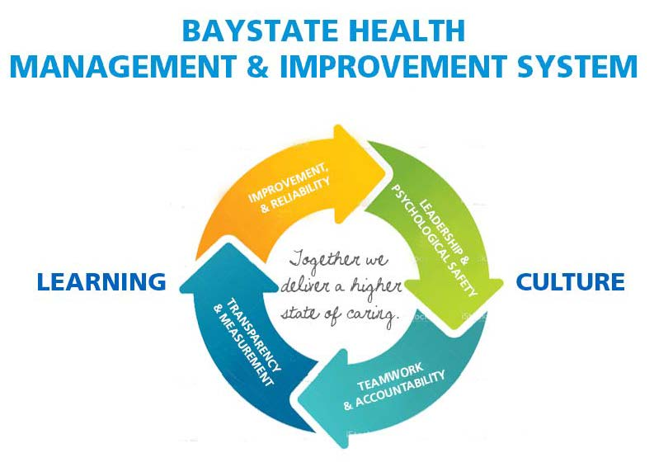
Baystate Health Management & Improvement System

Slide 4
Survey Summary
Teamwork
  39% say it is difficult to speak up with a problem about patient care
  42% say disagreements are resolved appropriately
  66% say dealing with difficult colleagues is consistently a challenging part of my job
Safety
  47% say my suggestions about quality would be acted on
  41% say the values of leadership are the same as the values that people in this work setting think are important

Slide 5
BHMIS FRAMEWORK
CULTURE
Leadership
Psychological Safety
Teamwork
Accountability
LEARNING
Transparency
Measurement
Improvement
Reliability

Slide 6


Slide 7

Psychological Safety
We are our own image consultants and best image protectors
To protect one’s image, if you don’t want to look:
STUPID
Don’t ask questions
INCOMPETENT
Don’t ask for feedback
NEGATIVE
Don’t be doubtful or criticize
DISRUPTIVE
Don’t suggest anything innovative
Source: Amy Edmondson
Notes:
In order for the learning system to generate and institutionalize improvements, we need to make sure there is psychological safety.
Amy Edmondson states that we are the owners of our image, our own “image consultants”.
In order to protect our image we don’t want to look:
Stupid; therefore Don’t ask questions
Incompetent; therefore Don’t ask for feedback
Negative; therefore Don’t be doubtful or criticize
Disruptive; therefore Don’t suggest anything innovative
When psychological safety exists in a unit or organization, these things don’t exist, and, in fact, aren’t tolerated. Creating psychological safety is one of the critical roles of leaders at all levels of the organization.

Slide 8


Psychological Safety
Psychological safety is a belief that one will not be punished or humiliated for speaking up with ideas, questions, concerns, or mistakes.
A shared sense of psychological safety is a critical input to an effective learning system.
Allows cross-disciplinary teams to overcome inhibiting effects of status differences
Psychological safety predicts engagement in quality improvement work
Psychological Safety and Learning Behavior in Work Teams. Administrative Science Quarterly, Vol. 44, No. 2 (Jun., 1999), pp. 350-383, Amy Edmondson
Nembhard IM Edmondson AC. Journal of Organizational Behaviour 2006 27:941-966

Slide 9
Culture: Psychological Safety Behaviors
Asks about breaches in professionalism & psychological safety
Encourages team members to cross monitor and report difficult interactions
                Makes personal connection with all team members
                Ensures familiarity among team members
Models responding to feedback positively
Does not judge

Slide 10
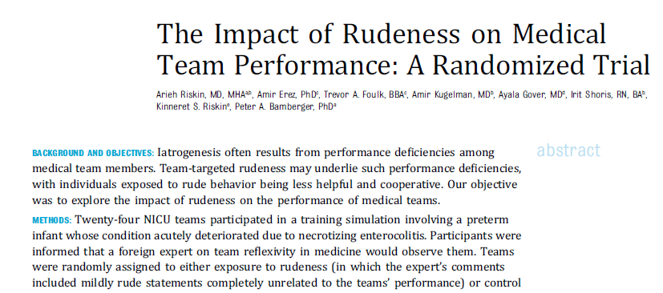
Pediatrics, 2015

Slide 11
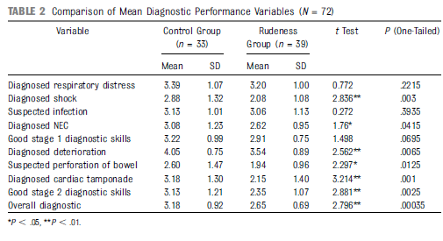
Diagnostic Performance

Slide 12
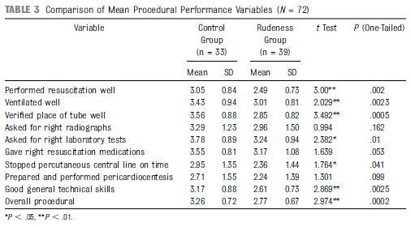
Procedural Performance

Slide 13
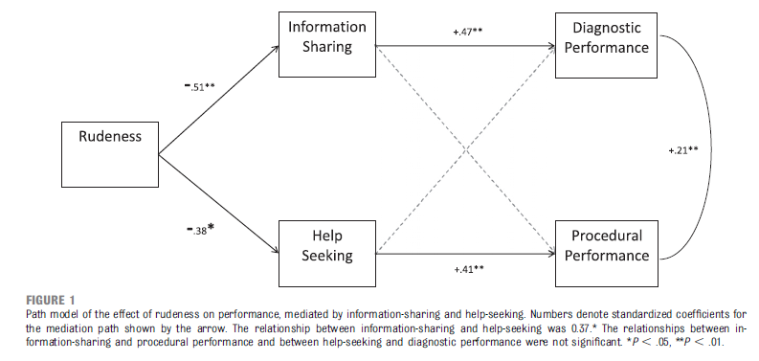

Slide 14
Baystate Welcome Challenge

Slide 15
Psychological Safety
“In this work setting it is difficult to speak up if I perceive a problem with patient care”
UNIT | 2015 | 2016
Emergency Department | 43% | 36%
Outpatient Surgical Center | 33% | 24%
Sterile Processing Department | 60% | 36%
Inpatient Operating Rooms | 35% | 35%
Daystay/Outpt Operating Rooms | 43% | 23%
Inpatient Pre-Op PACU | 47% | 56%
SICU | 44% | 44%
MICU | 19% | 45%

Slide 16
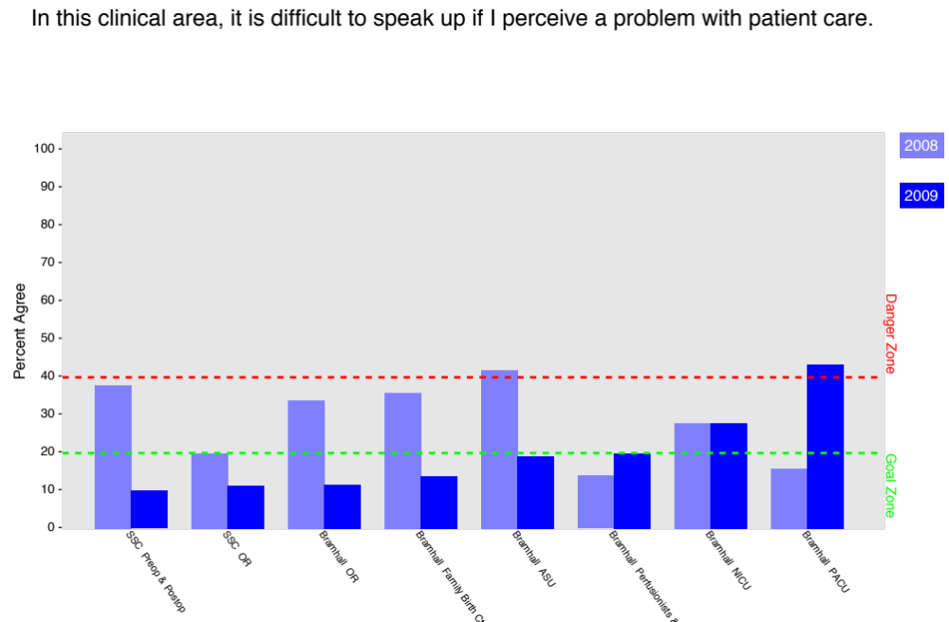

Slide 17
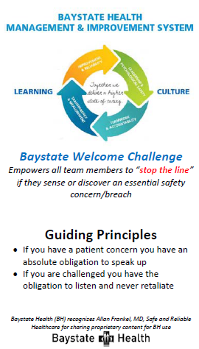

Slide 18
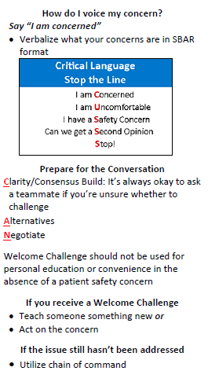

Slide 19
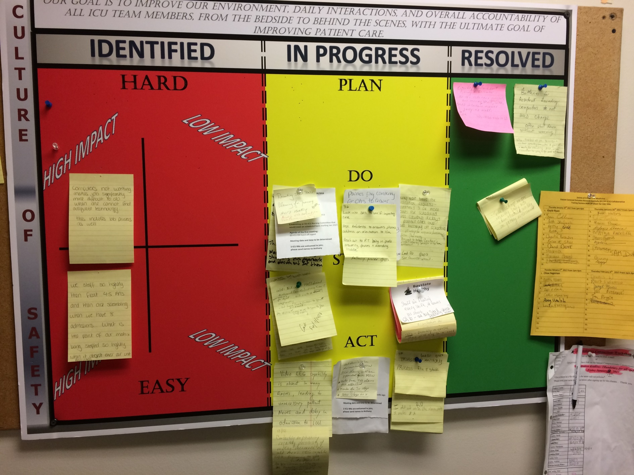
Learning Board

Slide 20


Slide 21
